Slide 1

Tuning South East Asia - TASE
Third General Meeting
Using Tuning approach to design a Degree Programme
Pablo Beneitone
Jakarta, 21 March 2018

Slide 2
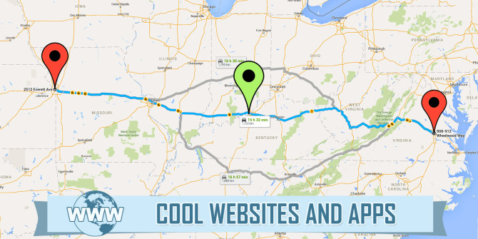
Where are we now?

Slide 3
EXPECTED OUTCOMES
DESIGN
IMPLEMENTATION

Slide 4
EXPECTED OUTCOMES
24
Univ.
DESIGN
4
Univ.
DESIGN
IMPLEMENTATION

Slide 5
DESIGN
IMPLEMENTATION
West Visayas State University
Teacher Education
Sanata Dharma University
Teacher Education
4
Univ.
University Sains Malaysia
Civil Engineering and Medicine
University of Malaya
Medicine
Notes:
5

Slide 6
Where are we now?
24
Univ.
DESIGN
3GM
4GM
5GM
4
Univ.
DESIGN
IMPLEMENTATION
3GM
4GM

Slide 7
How do we get here?

Slide 8


Slide 9

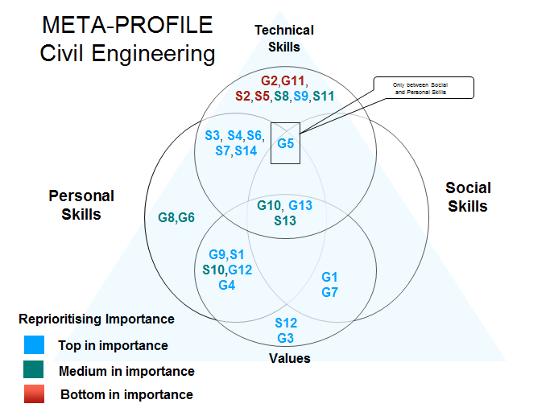
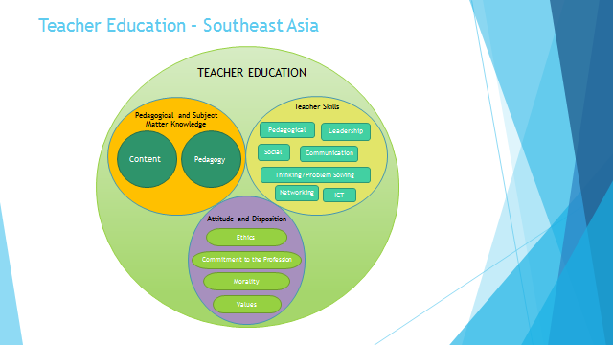
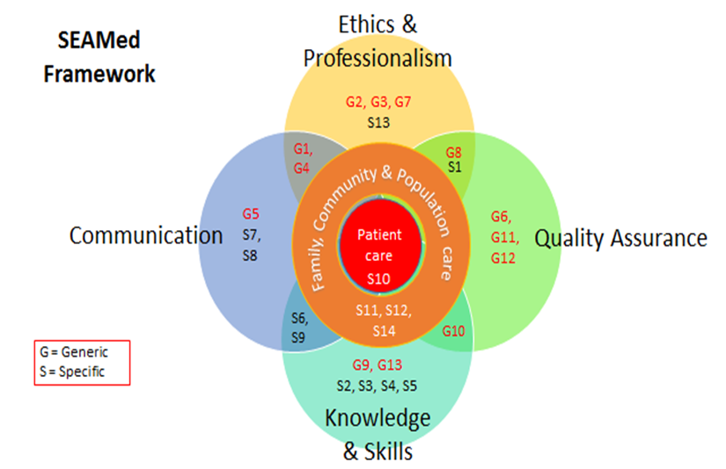
Meta profile

Slide 10
Meta profile
Degree profile
Programme
Institutional level
C
Competences
LEARNING OUTCOMES

Slide 11
DESIGN

Slide 12
10
steps for designing

Slide 13
DESIGN
NAME and TYPE of the programme
1
NEW
REVISED
JOINT
Agree on the name which is clear and reflects the aims and
the purpose of the programme; please mention if it is a new
or revised programme
HELP QUESTION:
1. Does the name reflect the aims and purpose of the programme?

Slide 14
EXAMPLES
NAME and TYPE of the programme
1
Bachelor of Engineering (Honours) (Civil Engineering)
Bachelor of Medicine and Bachelor of Surgery (MBBS)
Doctor in Medicine
Bachelor of English Education Study Programme
Bachelor of Elementary Education (BEEd) Program)

Slide 15
DESIGN
LENGTH and LEVEL of the programme
2
LENGTH …. XX MONTHS
LEVEL Bachelor? Master?
Define and indicate length and level of the programme; indicate if
the programme gives access to further studies
HELP QUESTIONS:
Is it clear what length of the programme is (in months)?
Is the programme at bachelor or master level?
Is a possible progression from this degree to further studies made clear?

Slide 16
EXAMPLES
LENGTH and LEVEL of the programme
2
This programme lasts eight semesters (four months each), including two semesters for internship and end of course paper.
Length of programme: 195 weeks over 10
semesters (5 years)
Level: Bachelor
38 courses

Slide 17
DESIGN
SOCIAL NEED for the programme
3
State what local, national or global needs the programme has
been (re)designed to meet; include a justification for the
programme in terms of the local / national / international social
needs + a mention of why the programme has been revised
HELP QUESTIONS:
It is clear why the programme is necessary – what social needs relevant for the local/national (as well as possibly international) context it has been (re)designed to meet?
Is it clear why the programme has been revised, what stipulated the revision of the programme?

Slide 18
EXAMPLES
SOCIAL NEED for the programme
3
The Bachelor of Engineering (Honours) (Civil Engineering) is being accreditated by the Board of Engineers Malaysia (BEM) through the Malaysian Engineering Accreditation Council (EAC).
Malaysia is a signatory of the WASHINGTON ACCORD under the International Engineering Alliance and as a result GRADUATES from a programmes that has been accredited by the EAC will gain global recognition; allowing global employability as well as global credit recognition for post graduate studies
It is therefore imperative that the Bachelor of Engineering (Honours) (Civil Engineering) programme is being designed and delivered to achieve the desired programme outcomes (PO), and to ascertain that all its graduates will have the appropriate generic and specific competencies. A systematic manner to assess graduate outcome attainment has been employed at the School of Civil Engineering, Universiti Sains Malaysia, the owner of this programme.

Slide 19
DESIGN
Future FIELDS OF OCCUPATION of graduates
4
Indicate where students who successfully complete the
programme can work – what type of occupations and jobs they are
likely to have;
HELP QUESTIONS:
Does the description help students to have a clear (and realistic!) idea of future sectors of employment or further study possibilities?
Is the language comprehensible to prospective students?
Is the list of potential occupations sufficiently detailed?

Slide 20
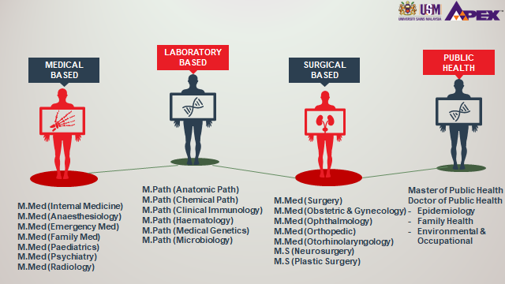
EXAMPLES
Future FIELDS OF OCCUPATION of graduates
4

Slide 21
DESIGN
DESCRIPTION of the DEGREE PROFILE of the programme
5
C
LEARNING OUTCOME
Express the desired graduate profile in terms of competences and list these,
indicating which you consider to be generic and/or subject - specific.
Formulate programme- level expected learning outcomes, indicating which
competence each of them is related to; check for consistency.
1. Does the description include both generic and subject-specific competences?
2. Are competences defined in a way that both students and staff can understand?
3. Have programme-level learning outcomes been formulated?
4. Are they clear and well formulated with an action verb, content and context?
5. Are they measurable?

Slide 22
DESIGN
DESCRIPTION of the DEGREE PROFILE of the programme
C1
5
C2
C3
C6
C7
C4
LEARNING OUTCOME at Programme Level
LEARNING OUTCOME at Programme Level
C4
C8
LEARNING OUTCOME at Programme Level
C5
C9
Degree profile

Slide 23
DESIGN
COMPETENCE
  What is according to Tuning?
  Is a broad concept
  Represents a dynamic combination of:
    - Knowledge and understanding at different levels
    - Skills and abilities
    Attitudes and values
  Competences are formed in various course units and assessed at different stages.
  Some competences are subject area related (specific to a field of study) while others are generic (common to any degree programme)

Slide 24
DESIGN
  What is a according to Tuning?
  Statements of what a learner is expected to know, understand and be able to demonstrate after completion of learning.
  They can refer to a single course unit or module or a degree programme.
  Should give a precise overview of what has been learned and has been demonstrated through assessment.
  They should be:
- Specific
- Objective
- Achievable
- Useful
- Relevant
- Standard-setting
LEARNING OUTCOME

Slide 25
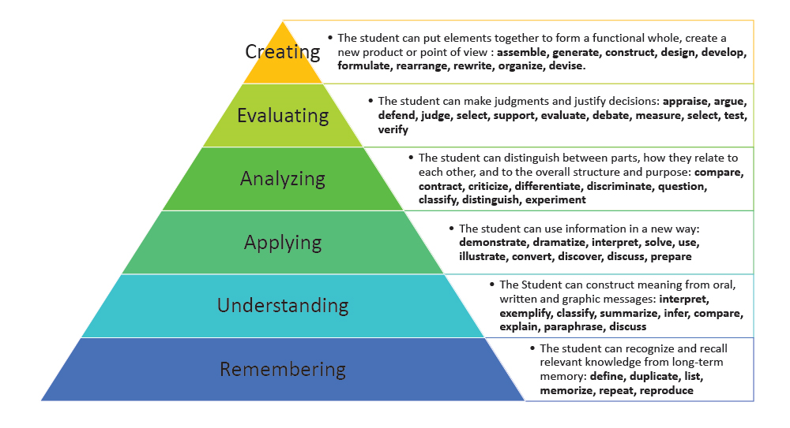
DESIGN
Bloom´s taxonomy
Notes:
25

Slide 26
DESIGN
Some examples how to write learning outcomes
Bloom´s taxonomy (updated)
Remembering: define, describe, draw, find, identify, label, list, match, name, quote, recall, recite, tell, write
Understanding: clasify, compare, exemplify, conclude, demostrate, discuss, explain, identifiy, illustrate, interpret, paraphrase, predict, report
Applying: apply, change, choose, compute, dramatize, implement, interview, prepare, produce, role play, select, show, transfer, use
Analysing: analyse, characterize, classify, compare, contrast, debate, deconstruct, deduce, differentiate, discriminate, distinguish, examine, organize, outline, relate, research, separate, structure
Evaluating: appraise, argue, assess, choose, conclude, critique, decide, evaluate, judge, justify, predict, prioritize, prove, rank, rate, select, monitor
Creating: construct, design, develop, generate, hypothesise, invent, plan, produce, compose, create, make, perform, plan, produce
(Anderson and Krathwohl, 2001)

Slide 27
DESIGN
DESCRIPTION of the DEGREE PROFILE of the programme
5
Generic Competence
Problem
Solving
Definition: Identifying, analysing and defining the significant elements constituting a problem in order to solve it effectively and with good criteria.
LEARNING
OUTCOMES
at
Programme
Level
1. Identify and analyse a problem to generate alternative
solutions, applying methods learned
2. Use own experience and criteria to analyse the causes of
a problem and construct a more efficient, effective solution
3. Propose and construct solutions to problems in different
fields, with an overall view

Slide 28
EXAMPLES
DESCRIPTION of the DEGREE PROFILE of the programme
5
Competence | Type | Definition | LEARNING OUTCOMES at programme level
Ability to conduct research | Generic | Ability to use geoscientific knowledge to plan and carry out basic research in various areas of geoscience using field investigation techniques and laboratory analysis | 1. Identify research problems in three different areas of geoscience (…, … and …) and formulate research questions that can be solved individually as a result of 3-4 month research projects using field investigation techniques and laboratory analysis; 2. develop an aligned research plan with feasible internal deadlines and measurable progress indicators; 3. use appropriate field investigation techniques and laboratory analysis procedures in order to carry out the plan respecting the deadlines and making adjustments necessary to respond to the target research question(s).

Slide 29
DESIGN
LINK of the DEGREE PROFILE with the META-PROFILE
6
Compare your programme graduate profile with the meta-profile
agreed for your subject area, identifying commonalities and
differences;
HELP QUESTIONS:
Is it clear which elements of the meta-profile are included in the degree profile and which are not?
2. Are the reasons for including the elements stated in the description?

Slide 30
DESIGN
Context
Degree Profile
The Degree Profile takes into consideration the professional and social needs at the local- regional or national level for which it is built

Slide 31
DESIGN
University Strengths
Degree Profile
Each University has a set of strengths on which to build
Each university has a mission to fulfill
Profiles bear the mark of the University where they originated

Slide 32
DESIGN
Meta-profile
Degree Profile
The Profile gains capacity for being recognized through the Meta-Profile

Slide 33
DESIGN
Context
Degree Profile

Slide 34
DESIGN
Context
University Strengths
Degree Profile

Slide 35
DESIGN
Context
University Strengths
Meta-profile
Degree Profile

Slide 36
DESIGN
Context
University Strengths
Meta-profile
Degree Profile
Degree Profile
PROGRAMME

Slide 37

DESIGN
Degree profile
University A
  Bridging between Meta-profile and reality

Slide 38
DESIGN
Degree profile
University B
  Bridging between Meta-profile and reality

Slide 39
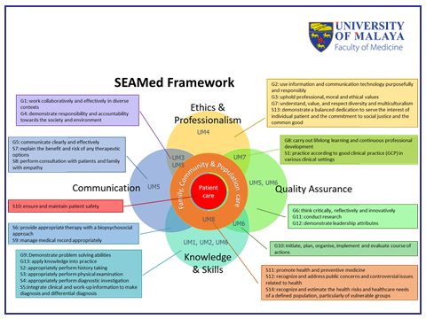
EXAMPLES
LINK the DEGREE PROFILE with the META-PROFILE
6

Slide 40
DESIGN
STRUCTURE of the PROGRAMME
7
LEARNING OUTCOME
List the courses/modules/units that make up the programme; for each of the
units, indicate its intended learning outcomes, as well as teaching, learning
and assessment strategies used to ensure that students achieve the unit
learning outcomes. Check the alignment within each unit.
Is there a list of the courses/modules/units that make up the programme?
Is information about intended learning outcomes and teaching, learning and assessment strategies provided for each programme unit?
Are teaching and learning activities appropriate for the learning outcomes of each unit/course/module?
Can the assessment methods used in each unit/module/course (a) promote and (b) measure the achievement of all the unit learning outcomes?
Are unit-level learning outcomes, teaching and learning activities and assessment tasks aligned logically?
Is there a general balance (no excessive repetition or excessive variety) in teaching, learning and assessment strategies across the different programme units?

Slide 41
EXAMPLES
STRUCTURE of the programme
7

Slide 42
EXAMPLES
STRUCTURE of the programme
7

Slide 43
DESIGN
Programme overall CONSISTENCY
8
Check the programme overall consistency (both at the unit level and
at the inter-unit/programme level).
Does each unit/module/course contribute to the achievement of at least one programme-level learning outcome?
Are all of the programme-level learning outcomes covered in the units/modules/courses of the programme?
Is there a progression and coordination of unit learning outcomes towards the development of each programme-level learning outcome / each competence of the graduate profile?
Is each programme-level learning outcome addressed in enough programme units to be achieved by students?

Slide 44
DESIGN
Programme overall CONSISTENCY
Degree profile
Programme
C6
C2
C7
C1
C8
C9
C3
C4
C5
C10

Slide 45
EXAMPLES
Programme overall CONSISTENCY
8

Slide 46
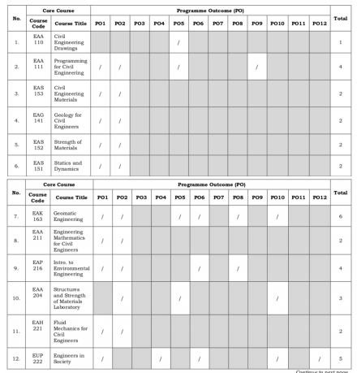

EXAMPLES
Programme overall CONSISTENCY
8

Slide 47
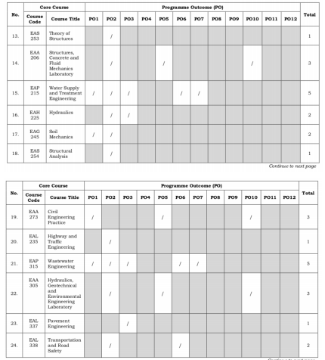
EXAMPLES
Programme overall CONSISTENCY
8

Slide 48
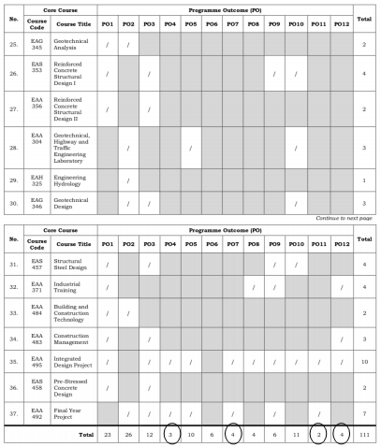
EXAMPLES
Programme overall CONSISTENCY
8

Slide 49
DESIGN
Internal QUALITY CONTROL/ENHANCEMENT
9
State how internal quality control will be carried out and the
improvements identified as necessary will be incorporated
HELP QUESTIONS:
How will feedback be obtained and from whom?
Who will be involved in analyzing feedback and deciding on the improvements necessary?
How will such improvements be implemented and their success monitored?
How will internal unit and programme level quality control procedures be coordinated?

Slide 50
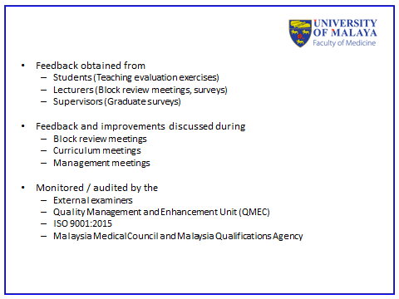
EXAMPLES
Internal QUALITY CONTROL/ENHANCEMENT
9

Slide 51
DESIGN
Other RELEVANT aspects
10
Add information on any other aspects your institution and/or
accreditation body requires for a programme (re)design proposal to
be considered for approval
HELP QUESTIONS:
Have you included information on all the other aspects your institution and/or accreditation body requires for a programme (re)design proposal to be considered for approval?

Slide 52
terima kasih banyak

